Slide 1
AI-POWERED TRAVEL PLANNER AGENT
CAPSTONE PROJECT
Presented By:
1. Krishna - GGDSD CHD - BCA

Slide 2
OUTLINE
Problem Statement
Proposed System/Solution
System Development Approach
Algorithm & Deployment
Result
Conclusion
Future Scope
References

Slide 3
Problem Statement
Problem Statement No.5- A Travel Planner Agent is an AI-powered assistant that helps users plan trips efficiently and intelligently. It uses real-time data to suggest destinations, build itineraries, and recommend transport and accommodation options. By understanding user preferences, budgets, and constraints, it tailors personalized travel plans. Integrated with maps, weather updates, and local guides, it ensures a smooth travel experience. The agent can also manage bookings, alert users to changes, and optimize schedules on the go. This smart assistant transforms complex travel planning into a seamless, enjoyable process.

Slide 4
Proposed Solution
The proposed solution is an AI-powered Travel Planner Agent that uses IBM Granite foundation models via Prompt Lab to generate personalized itineraries based on user input such as destination, interests, budget, and travel dates. The assistant:
Builds day-wise plans
Suggests transport and accommodation
Summarizes local weather
Operates entirely through natural language prompts

Slide 5
System Approach
Platform: IBM Cloud (Lite Tier)
Tools Used:
Watsonx.ai (Prompt Lab)
Granite-3.3-8B-Instruct model
Input: Natural language queries describing travel preferences
Output : Generated itinerary (text), structured day plans, suggestions
No-code/low-code workflow using prompt engineering

Slide 6
Algorithm & Deployment
Prompt-based approach (LLM instruction tuning)
No traditional algorithm; uses large language model (Granite) for text generation
Prompt template created with placeholders for:
Destination
Budget
Duration
Interests
Prompt Lab configured with:
Max tokens : 2000 , Min tokens : 200
Stop Sequence : “!” and “---”
Output style: bullet format, emojis, budget estimates
Output captured and exported for report/documentation

Slide 7
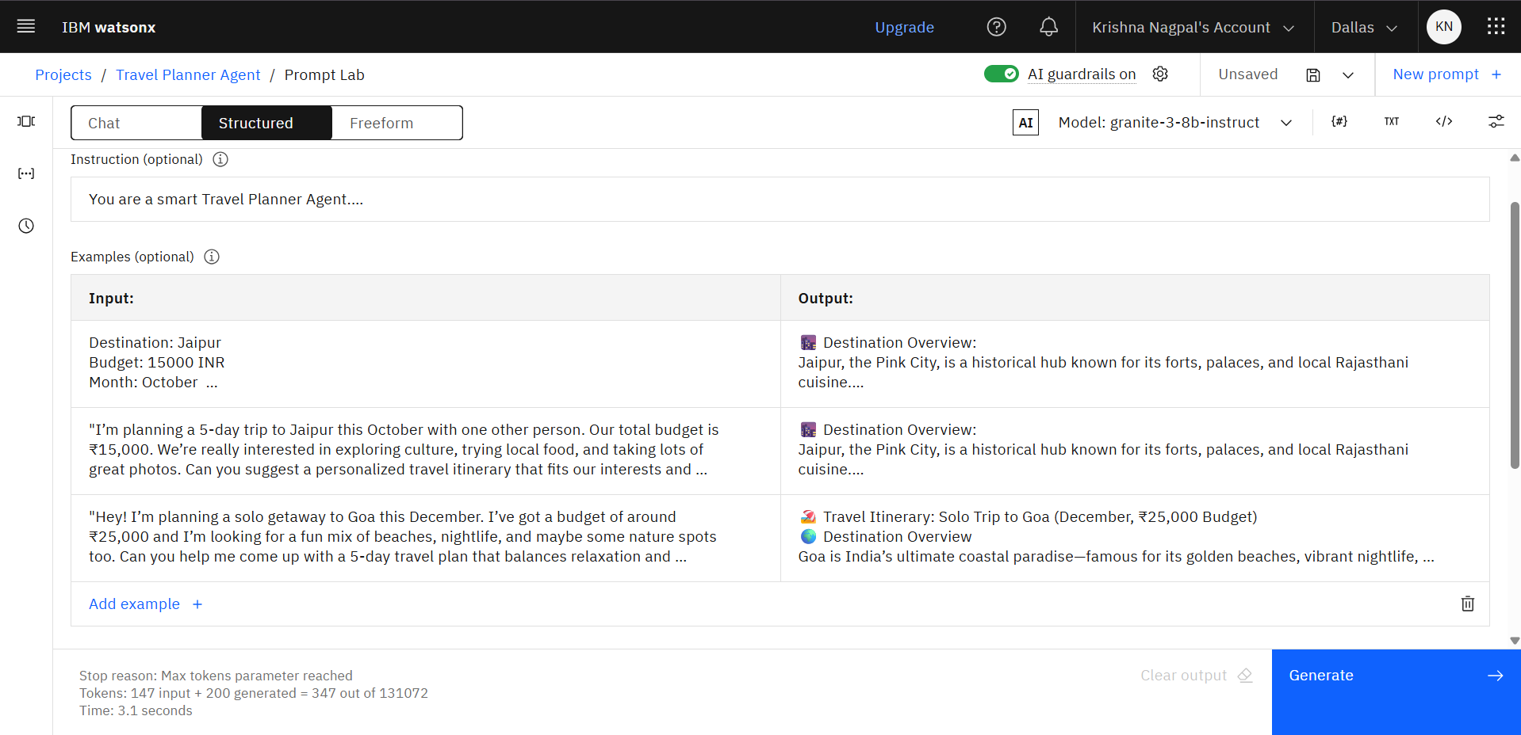
Result

Slide 8
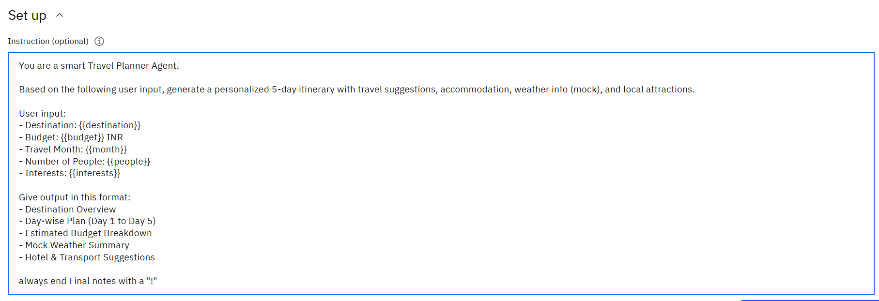
Result

Slide 9
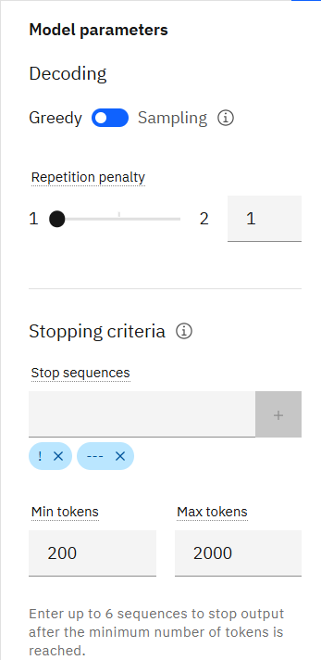
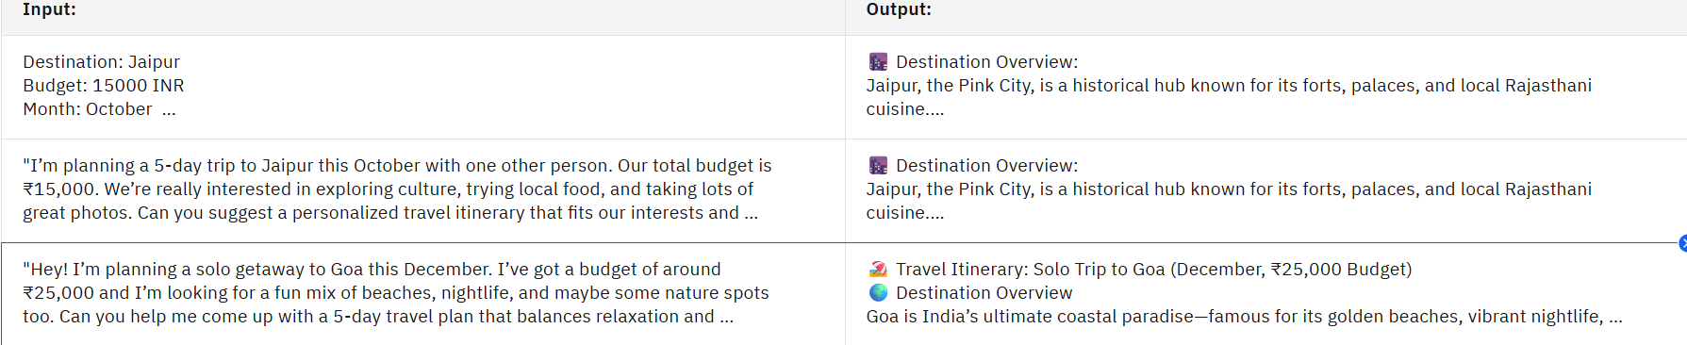
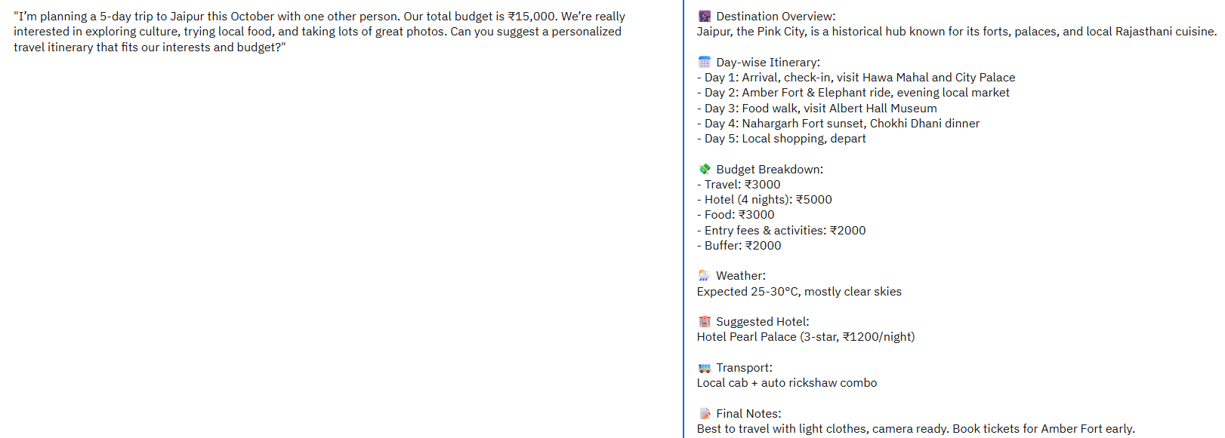
Result
Example Prompts with Outputs

Slide 10
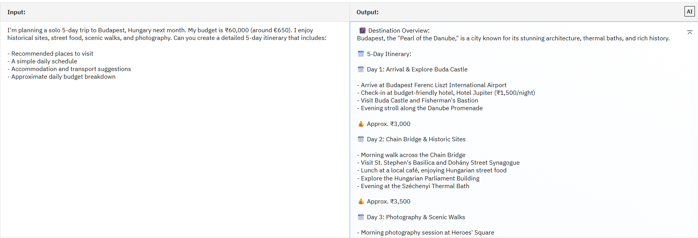
Result
Testing or Generating Output

Slide 11
Conclusion
Successfully built a low-code Travel Planner Agent using IBM Granite
Demonstrated LLM use cases in solving real-world, user-facing tasks
Learned prompt tuning, output formatting, and system limitations
Used only IBM Lite-tier services without deploying external code

Slide 12
Future scope
Extend project into a web-based chatbot interface
Add API integrations (weather, flights, hotel booking)
Include multi-language support using NLU services
Use larger models (e.g., Granite 20B) for richer, more complex planning
Deploy via IBM Cloud Functions or Flask for real-time app usage

Slide 13
References
IBM Granite Model Docs: https://www.ibm.com/docs/en/watsonx
IBM Prompt Lab Guide
Kaggle Datasets (Travel Preferences)
OpenWeatherMap API

Slide 14
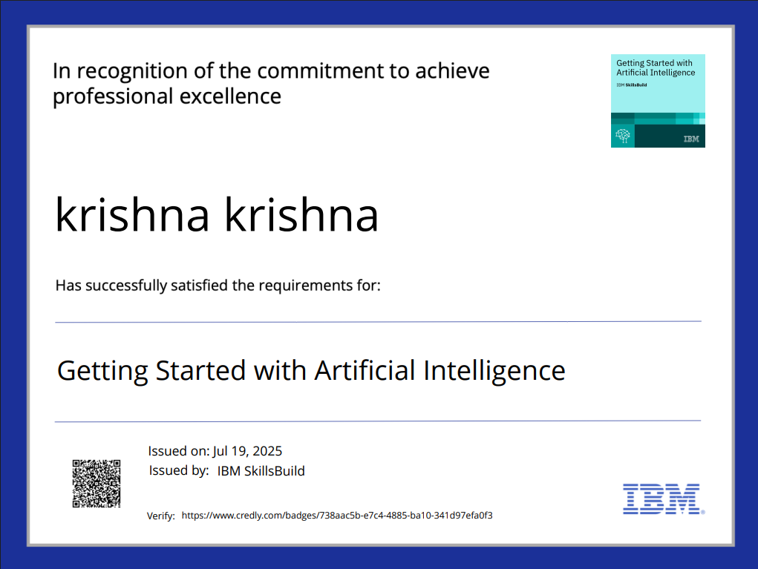
IBM Certifications

Slide 15
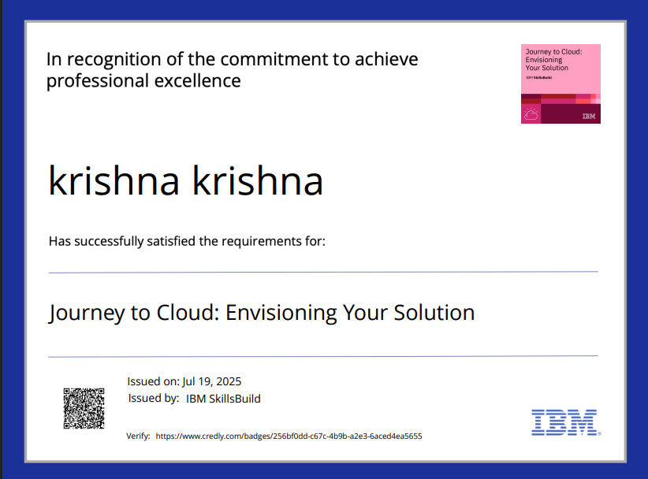
IBM Certifications

Slide 16
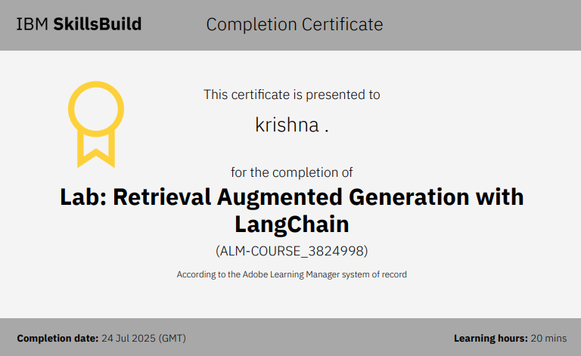
IBM Certifications

Slide 17
THANK YOU

